Slide 1
Don’t Fence Me In: Fragmented Markets for Tech and the Patent Acquisition Strategies of Firms
Ziedonis, Management Science, 2004
Youngsir Rha BADM549

Slide 2
Research Question
What factors interact to shape the patenting behavior of firms?
How do firms avoid being “fenced in” (limited) by owners of patented techs used?
Conditions under which firms expand patent portfolios to counter the potential economic hold-up problem?

Slide 3
Patenting and Fencing
One of the ways firms facilitate the flow of knowledge is by exercising legal rights to make, use, or sell technologies they internalize. (e.g. patenting)
Excessive patenting creates a problem in the tech market. (e.g. overfencing, underinvestment in commercialization of downstream tech, and effects of dense “thickets” of overlapping patent claims)
→ This paper examines the conditions under which an aggressive patenting strategy is an alternative way to avoid being “fenced in” by owners of tech.
→ Uses TCE and IP studies to do so.

Slide 4
Hold-up Problem and Patents
Hold-up problem is posed by outside patent owners when they expropriate economic rents from another.
TCE: firms facing hold-up problem will either internalize transactions regarding specific assets or underinvest where the risk is high.
A patent gives an exclusionary right, not an affirmative right. A firm does not own the rights to use the invention of doing so infringes on the patent rights of others.
A firm may face a make AND buy decision. (e.g., Intel was sued for infringing a patent unknown to them ex ante their large investments) → price of the legal rights of the patent and ex post bargaining position becomes important.

Slide 5
Theory Building
Firms that use outside inventions can safeguard their investments ex ante (e.g., joint venture or patent tools).
However, the costs and delays of contracting make it impossible for firms who build on tech whose ownership is dispersed in the market.
This condition increases the value of patenting for use in ex post licensing transactions.
Laws regarding patents mediate the effect.

Slide 6
Case Example for Theory Building
Example: A semiconductor manufacturer deciding to invest $1 billion in a new fabrication facility. Assume the firm has identified 1,000 patents it believes might be infringed on in the design or manufacture of its products. However, the firm is still unsure whether these patents are valid and, if so, the effective scope of their claims. Should the firm negotiate rights to use these technologies with their respective patent owners prior to building the facility?
Scenario 1: patents are all assigned to one firm | Scenario 2: patents are assigned to 1,000 different entities
(1) Contact the patent owner to secure a license or an alternative contractual arrangement before investing in the facility (2) Choose to invent around the patents (if possible). (3) License negotiation: reduce the per-patent cost of valuing the rights by restricting attention to the most valuable inventions | (1) Seek a right to use the patented technologies from each owner, BUT with a more careful examination of whether patents are valid and possibility of getting excluded from using the invention ex post (2) Unlikely to spread the valuation costs across individual owners due to context-specific nature of the asset → More reliance on ex ante solutions infeasible for the firm
The distributional characteristic of the firm’s external market for technology has important implications for the costs and potential delays associated with ex ante solutions.

Slide 7
Hypothesis 1
Firms will more aggressively patent when rights to complementary patents are distributed in the market (beyond what is otherwise predicted).
•Expropriation risks are higher for firms with assets that are costly to redeploy to alternative uses or users
•Ex ante contractual solutions are more costly (less feasible) for firms that draw on fragmented pools of external technologies.

Slide 8
Hypothesis 2
Aggressive acquisition strategy is important when:
External technology markets are highly fragmented
The anticipated cost associated with being “held up” is large
Semiconductor industry: large sunk investments in manufacturing facilities
Complexity
Interrelatedness (state-of-the-art facilities)
Investment decisions made years prior to a new product invention
Rapid depreciation
The effect of fragmented external rights on incentives to patent (H1) will be more pronounced among capital-intensive firms (all else equal).

Slide 9
Hypothesis 3a
Hypothesis 3b
Implications for Patent Acquisition Strategies
The role of laws in governing the strength and enforceability of patent rights
The U.S. legal environment during the 1980s effectively strengthened the rights of patent owners in the United States
→ Impact of disperse outside patent rights on firm patenting behavior will be amplified
The effect of fragmented external rights on incentives to patent (H1) will be stronger following the “pro-patent” shift in the U.S. legal environment (all else equal).
The interaction effect between fragmented rights and capital-intensity will be greater in magnitude following the “pro-patent” shift in the U.S. legal environment (all else equal).

Slide 10
Research Setting
Data: A total of 67 U.S. firms in the semiconductor-related industry during the 1980-1994 period, generating 667 observations.
Why semi-conductor?
Unique combination of capital and research intensity, short product life cycle→ magnified investment risk
Innovation in this industry is cumulative. new product need to build on prior investments→ affects firms incentive to patent
Most patents in this industry existed before U.S. legal reforms (“propatent” shift)→ can examine if patenting strategy became more responsive to the distribution of external patent rights

Slide 11
Method
Variables
DV: the number of successful patent applications made by a firm in a given year
IV: fragmentation index (FRAG), a dummy FRAG, an interaction term between FRAG and capital-intensity, and legal environment
Control variables: firm size, R&D spending, capital-intensity, Texas Instruments, annual time dummies
Model
Negative binomial specification
Expected number of patents during the year (t) for firm (i) is an exponential function of the firm’s R&D spending and other characteristics.
𝐸[𝑝_𝑖𝑡 ㅣ𝑋_𝑖𝑡 ]=𝜆_𝑖𝑡=exp⁡(𝑋_𝑖𝑡 𝛽+𝛾_𝑡)
𝛾_𝑡: the average patenting across all firms, adjusting for the changing mix of firms in the sample

Slide 12
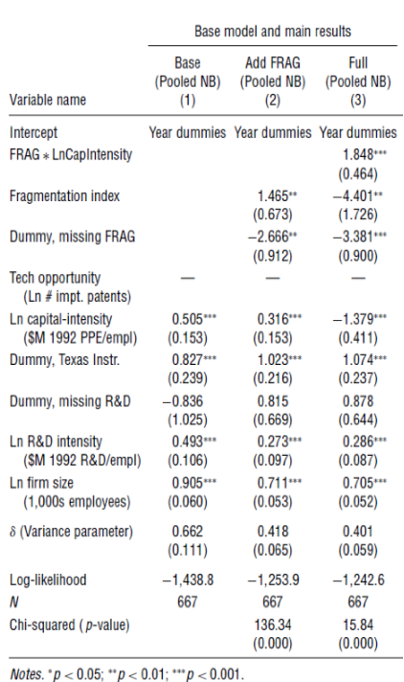
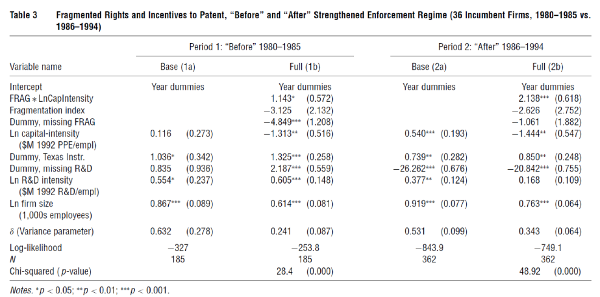
Results
H2
H1
H3

Slide 13
Conclusion
Interactions between the internal characteristics of firms and their environments affect not only the dispossession risks posed by outside patent owners but also how firms safeguard their investments.

Slide 14
Contributions
Strategic motives for patenting: strategic usage of patents vary considerably even within an industry and are driven by both firm-specific and environmental factors.
Provides empirical evidence regarding the determinants of patenting in semiconductors: “portfolio racing” was not driven by firm-level investments alone, but by the subset of capital-intensive firms using a fragmented pool of external technologies.
Explores the trade-offs among mechanisms (e.g. adjusting R&D programs or using patent tools) and identify the conditions under which an aggressive patent acquisition strategy is an alternative response.

